Slide 1
ANIMAL DISEASE PREDICTION USING
MACHINE LEARNING
Project Guide-
Prof. J. E. Kamalasekaran
Project Members- Exam Seat no:-
Akshay Shekade B150234372
Amit Wakade B150234412
Vishal Tayade B150234402
Shubham Makar B150234310

Slide 2
Problem Statement
To build a system which would provide hand hold support to users to detect their animal disease by analysing their symptoms using Machine Learning techniques.

Slide 3
MOTIVATION
In Rural regions sometimes we need the help of doctors, but due to lack of basic medical facilities people choose to ignore it or sometimes they may overvalue it. But it might lead to some serious concerns.
In rural areas, doctors are available but they are not specialists, so they may not give a thought to considering seriousness of disease.
There isn’t any existing system which can predict or detect the animal disease by just using their symptoms.
Our proposed system will really helps farmers through different aspects.

Slide 4
LITERATURE SURVEY
Paper Name Advantages Disadvantages
Multi-criterion Disease Detection Able to detect canine disease correctly . focussing on a particulare animal.
Using Machine Learning.(2019)
A Machine learning Approach to High Performance and accuracy rate Detection is not possible at an early stage
Automated Gait Analysis for the
noldus catwalk System.(2018)
A modelling of animal disease Easy to use In the given system practicle use of various collected
using artificial neural network.(2018) Disease get detected at an early Stage data is time consuming.

Slide 5
PROPOSED SYSTEM
• The proposed system acts as a decision support system That will help users to get information about diseases easily.
• The algorithm Random Forest Making Decision based on training data.
•It will predicate most accurate result and possible precautions , information about diseases and nearby information of nearby doctors.

Slide 6
Research Gap
The accuracies of various algorithms which are in use are :
these resultss can be improved by significant amount by introducing dependency.
The results can also be improved by continuous updates based on verified user’s logs.
Algorithm | Accuracy
Decision Tree | 65%
KNN | 45%
Naïve-Bayes | 60%

Slide 7
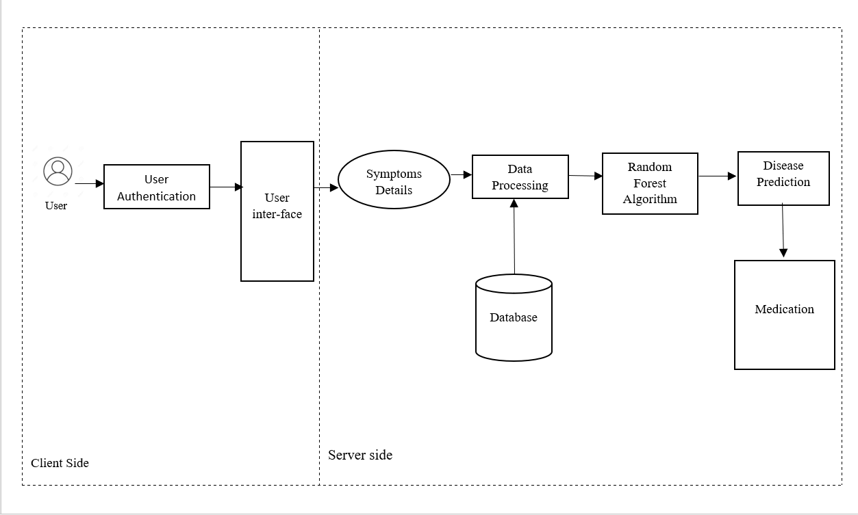
Architecture Of The System

Slide 8
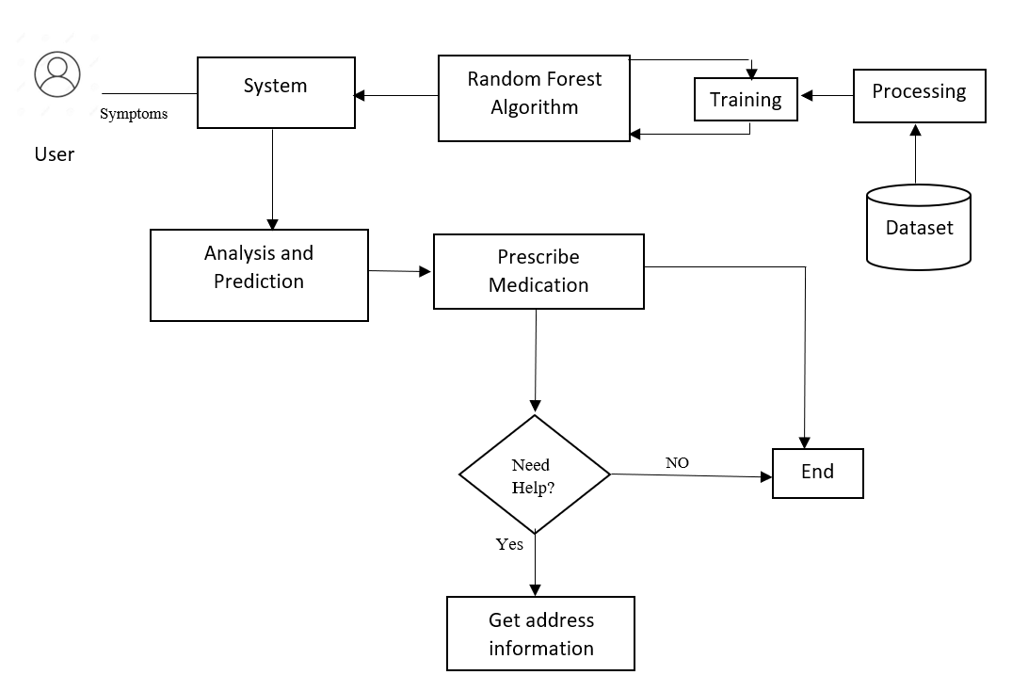
System Flow

Slide 9
Features
Acts as Virtual Health Advisor.
Provides detailed analysis to the user.
Connect with veterinarian and other stakeholders.
Uses modern technologies like machine learning and data mining.
Mobile application thus can be used from anywhere anytime.

Slide 10
IDEA matrix
Idea | Deliverables | Parameters affected
increase | User convenience | Application design
increase | Security | User authentication
avoid | Human negligence and confusion | Negligence and confusion
advance | There is no single platform that houses all the features in one place | Usability
develop | A system housing all the features needed in the disease prediction | Usability
increase | Classification accuracy | Algorithm choice
deliver | A product that provides more efficient disease prediction system | Speed

Slide 11
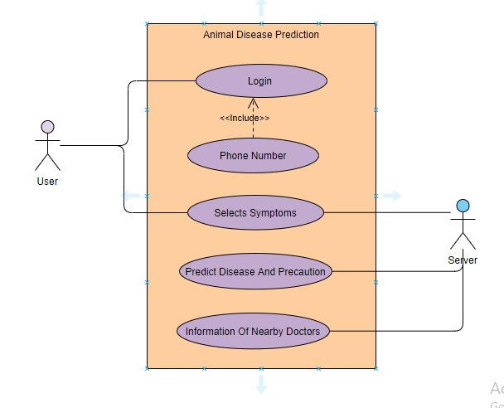
Use Case Diagram

Slide 12
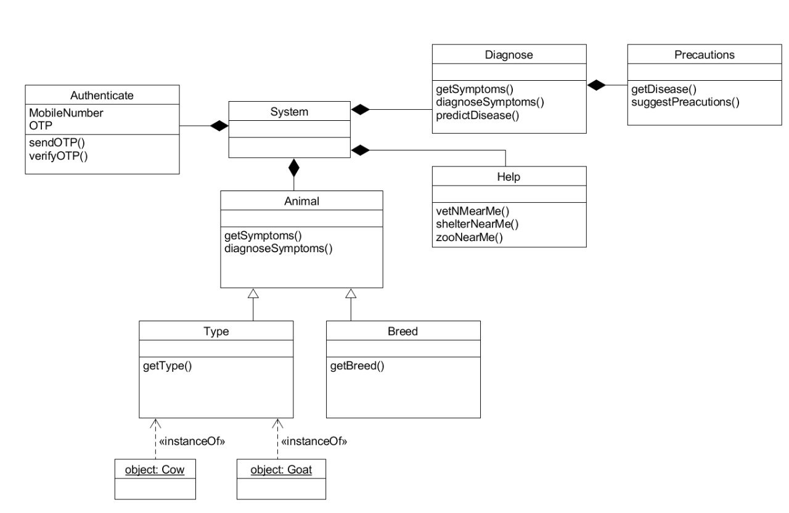
Class Diagram

Slide 13
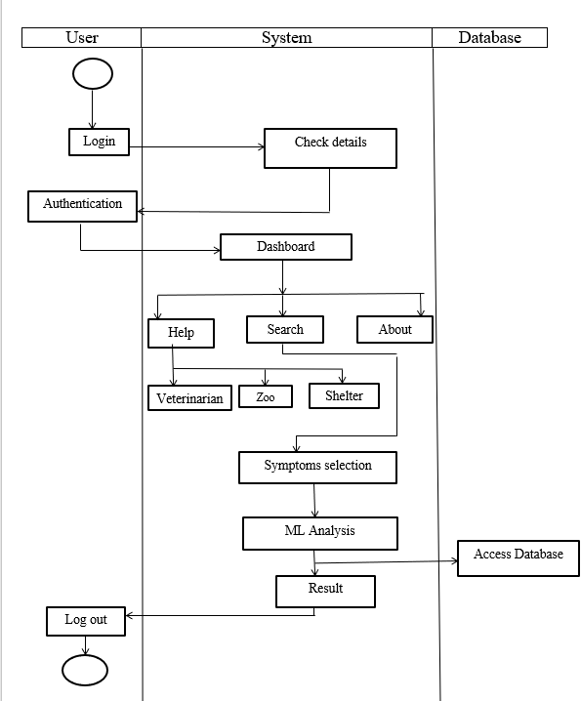
ACTIVITY DIAGRAM

Slide 14
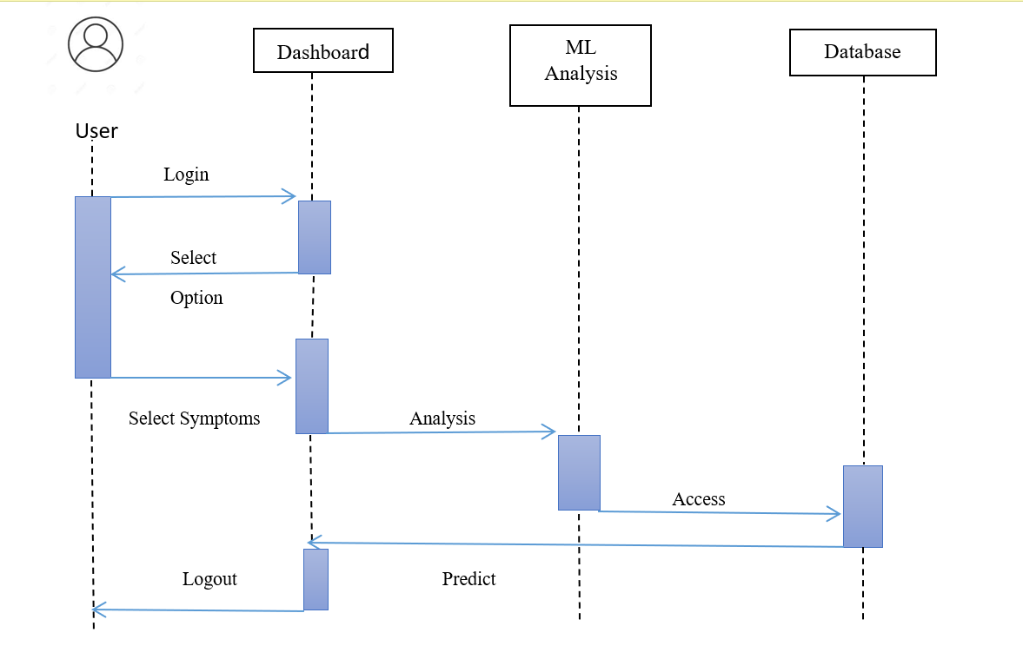
Sequence Diagram

Slide 15
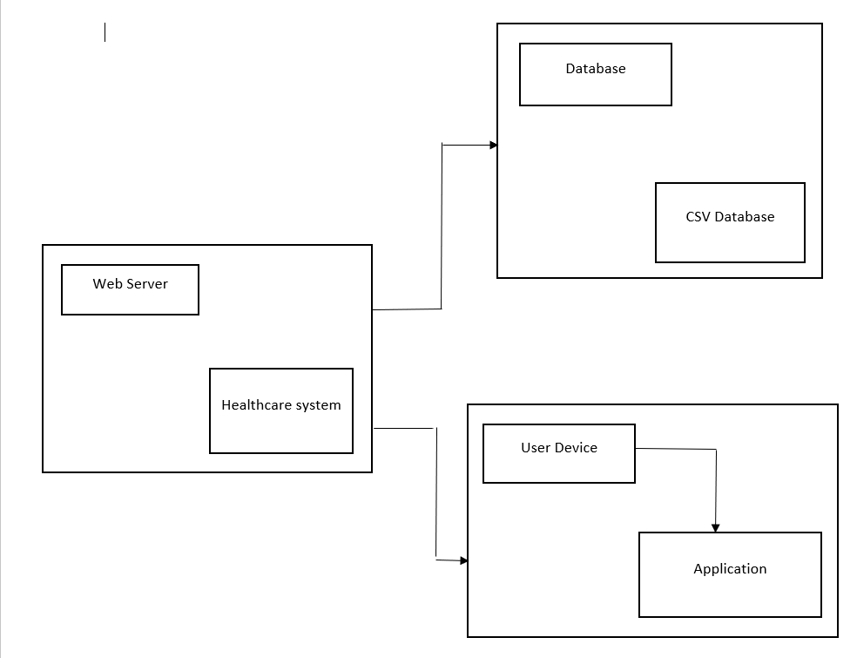
Deployment Diagram

Slide 16
WORKING
With the datasets already acquired from the Machine learning repository, We can now proceed with collecting the details of the Animal Symptoms.
Data like Animal Name, Breed and all Symptoms from the Users as a input.
Sending data to Random Forest Algorithm.
Random Forest Algorithm Internally Uses Decision tree.

Slide 17
After analyzing data it will return possible disease ,information about disease and antibiotics.
It will also Return Details of nearby doctors.

Slide 18
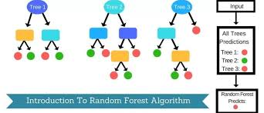
HOW RANDOM FOREST WORKS

Slide 19
HOW RANDOM FOREST WORKS
Random forest is a supervised learning algorithm.
The "forest" it builds, is an ensemble of decision trees, usually trained with the “bagging” method.
The general idea of the bagging method is that a combination of learning models increases the overall result.
Random forest is a great algorithm to train early in the model development process, to see how it performs.

Slide 20
FUTURE SCOPE
We Are looking forward to add Image Detection technique.
Users can take picture of any animal if they have some skin infection or reaction and upload it on system then they will receive possible medical suggestions.
suggestions on antibiotic drugs they may use.
They can also consult with Doctors online.

Slide 21
CONCLUSION
Proposed, is a Random Forest algorithm for predicting the disease Animals using the attributes collected from the user.
Proper adaptation of Algorithm for detecting the Diseases ,providing their Information , providing antibiotics Information and Providing information about nearby doctors Implemented efficiently.
Created easy to use Application for effective use.

Slide 22
REFERENCES
https://builtin.com/data-science/random-forest-algorithm
https://nadrsapps.gov.in/
https://dahd.nic.in/
https://vikaspedia.in/agriculture/livestock/general-management-practices-of-livestock/common-animal-diseases-and-their-prevention-and-treatments
Artificial Intelligence Engines is a book written by James V Stone.

